Slide 1
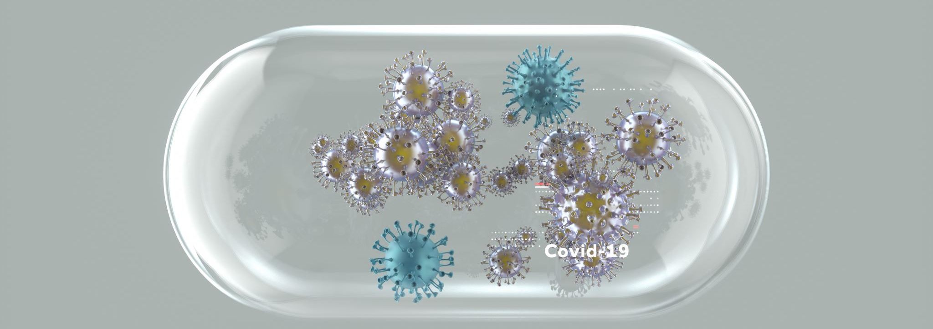
COVID-19 Diagnosis
By: Ayham Munther Al-Tamimi | Ashraf Abdulkhaliq

Slide 2

Problem statement
The whole world is suffering from COVID-19 disease and its proper and timely diagnosis. In response to this urgent need for accurate COVID-19 diagnosis, we're developing a system that uses artificial intelligence to analyze chest X-ray images. By training a computer vision model, our goal is to create a reliable tool that can quickly identify signs of COVID-19 in patients.

Slide 3
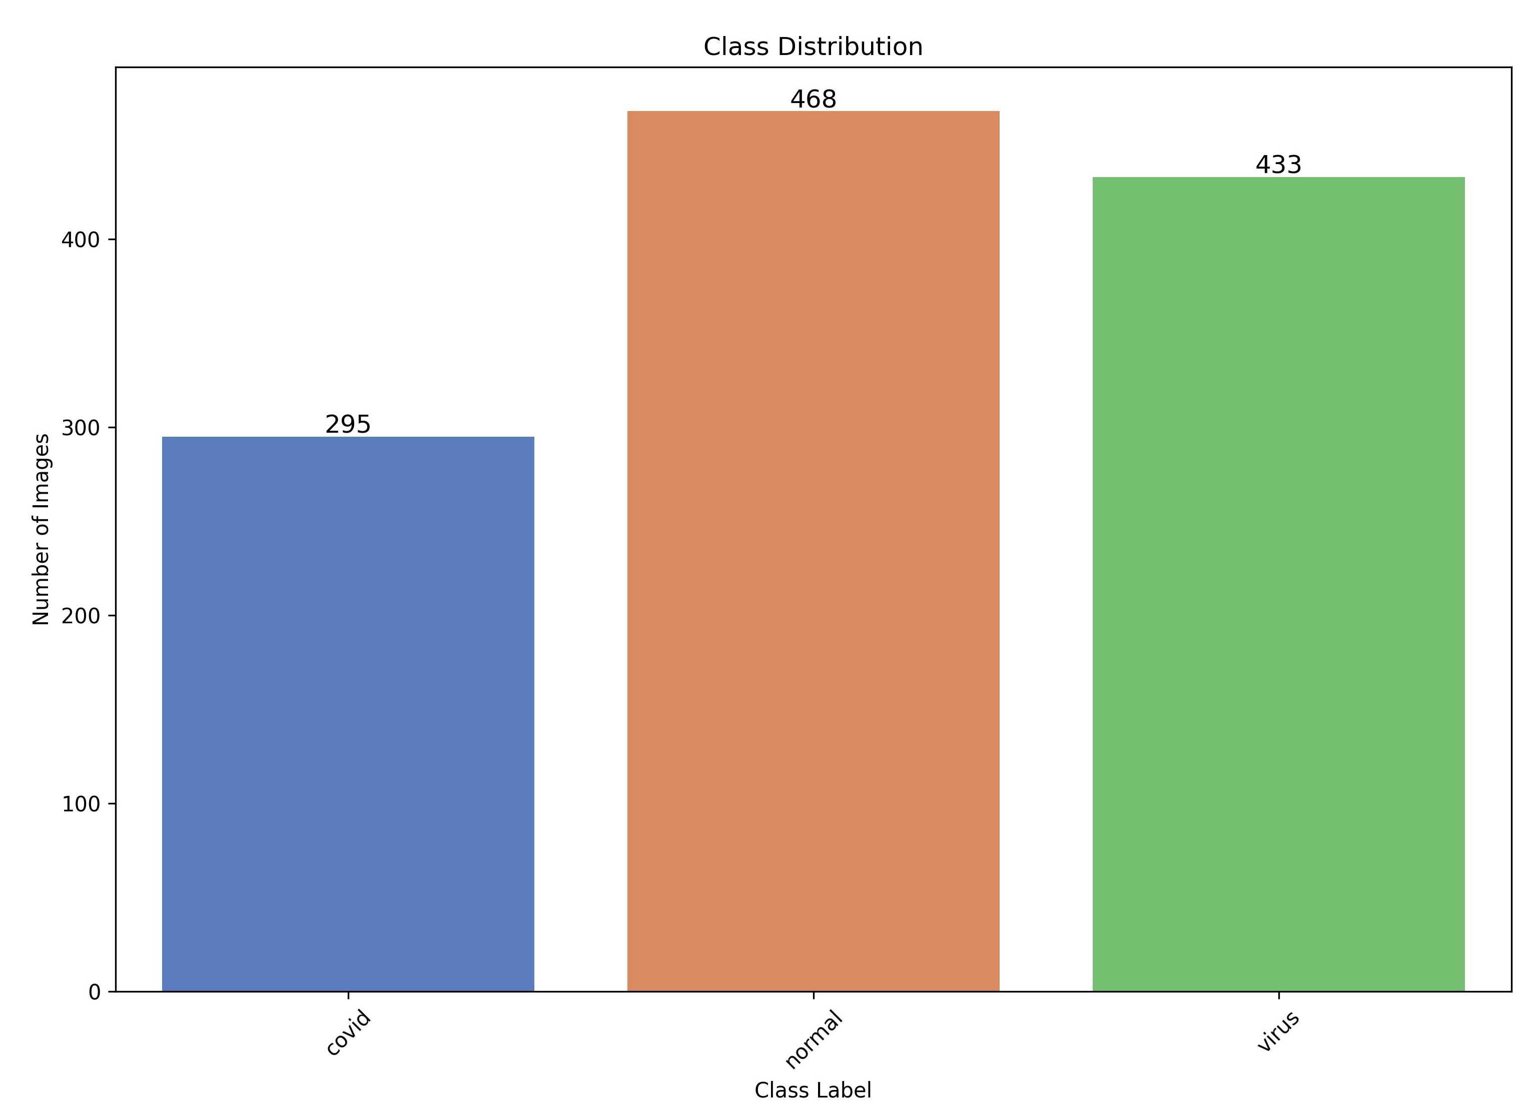
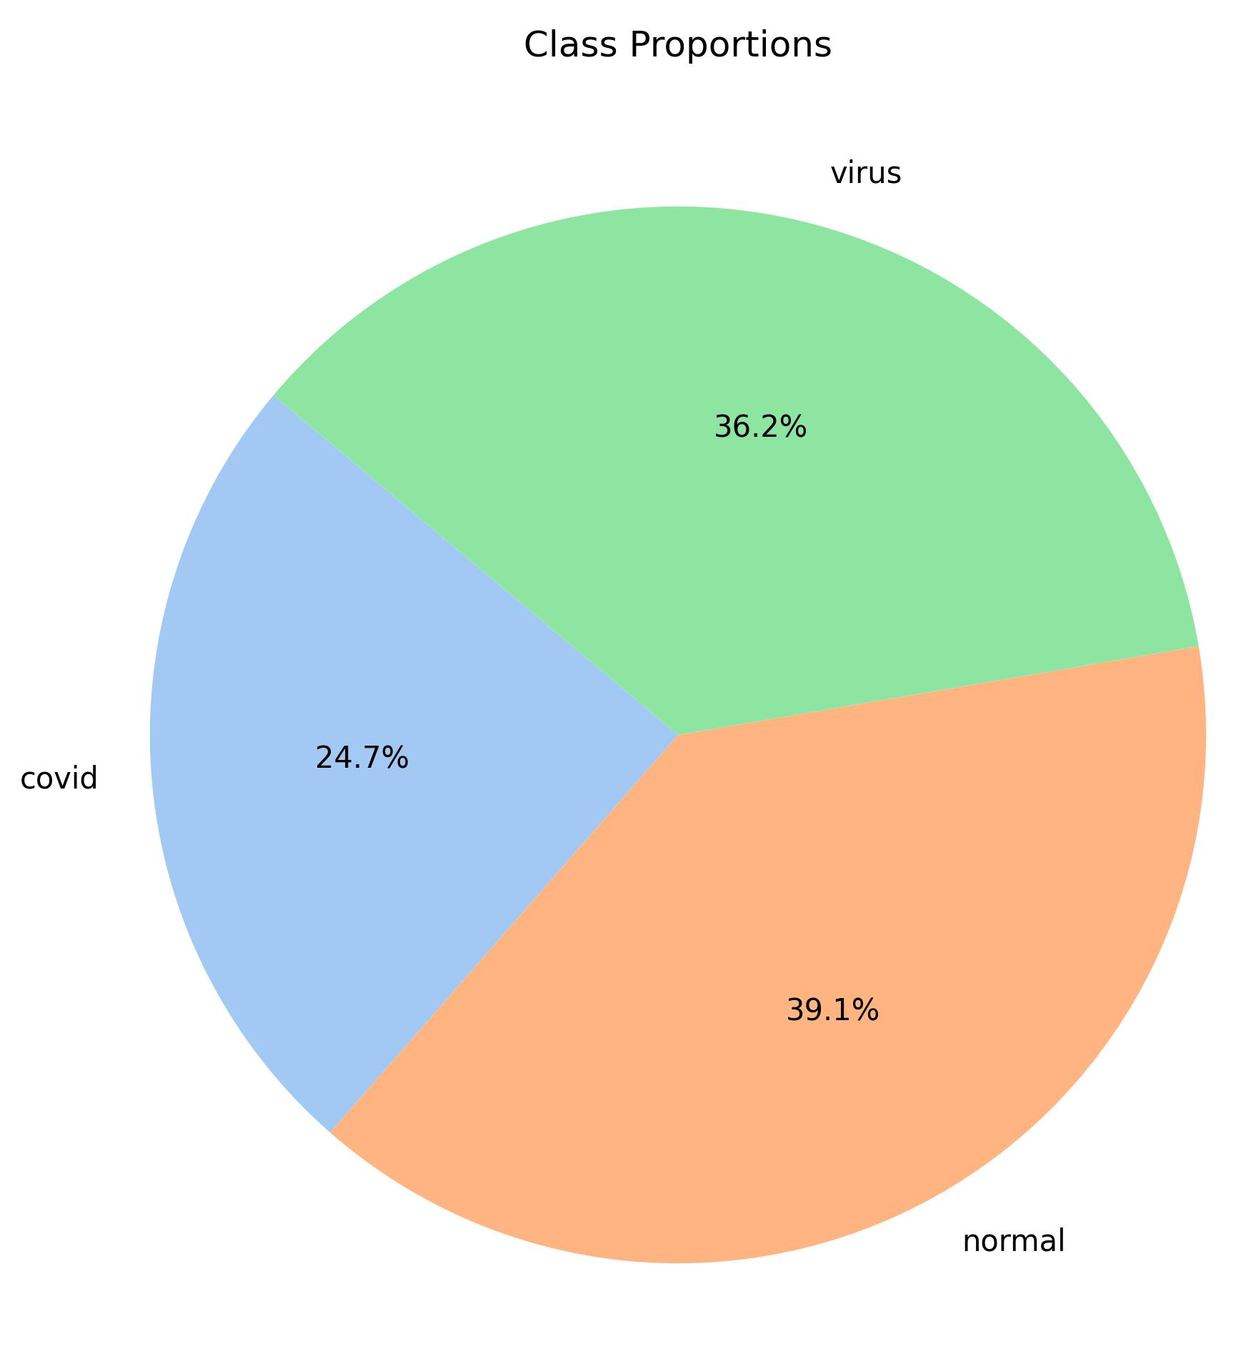
Dataset overview
Total: 1196 sample

Slide 4
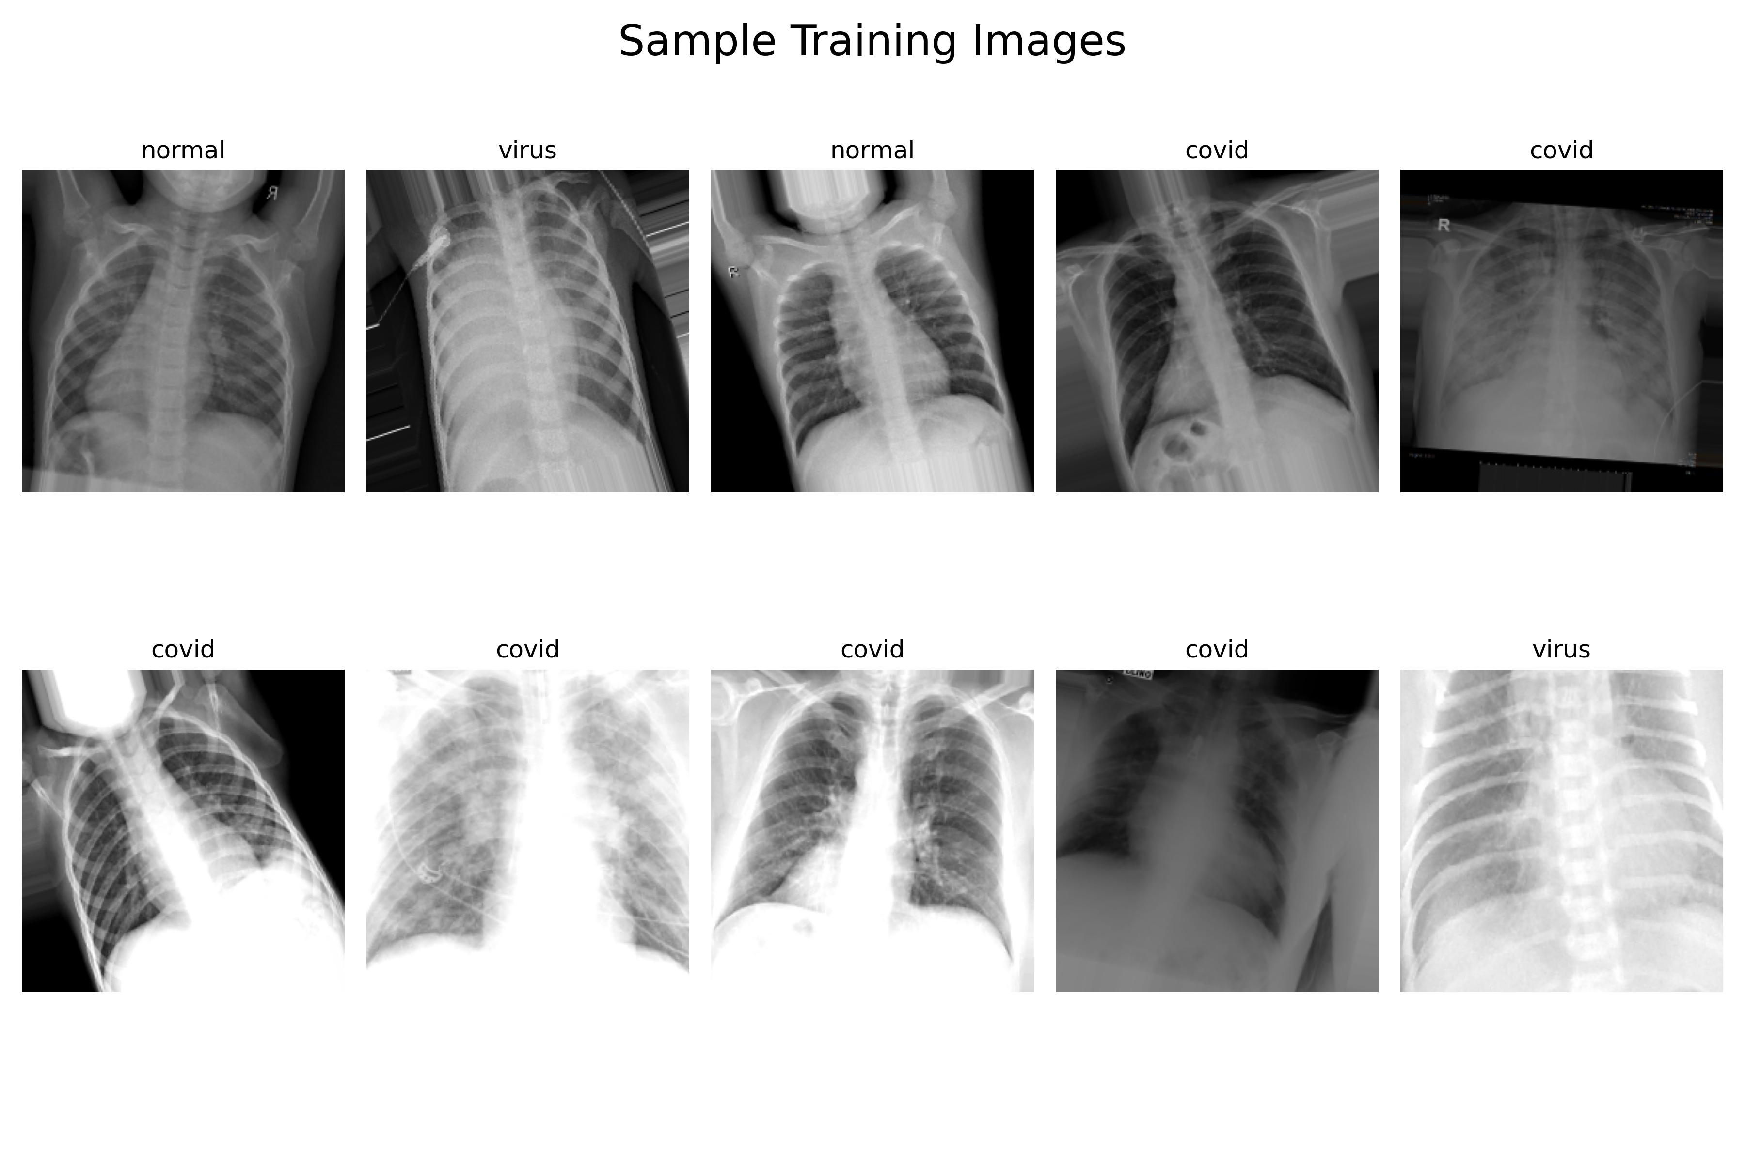
Dataset overview

Slide 5
Data Pre-processing
Rescale
Zoom
Shear
Rotation
Brightness Adjustment
Data Augmentation

Slide 6

Data Pre-processing
Train set
All set
Validation set
We did split our data into 80% training set (958 sample), and 20% validation set (238 sample)

Slide 7
Modeling
Hyper-parameters settings:
Image shape into 224 pixels height and 224 pixels width.
Batch size to 16 sample
# of Epochs to 30
We also used callbacks like early stopping and reduce learning rate

Slide 8
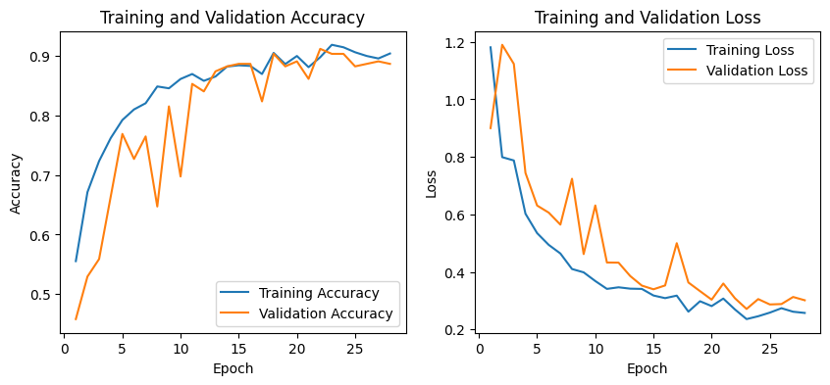
First Experiment (CNN)
Train loss: 0.2787
Test loss: 0.2877
Train accuracy: 0.9120%
Test accuracy: 0.8907%

Slide 9
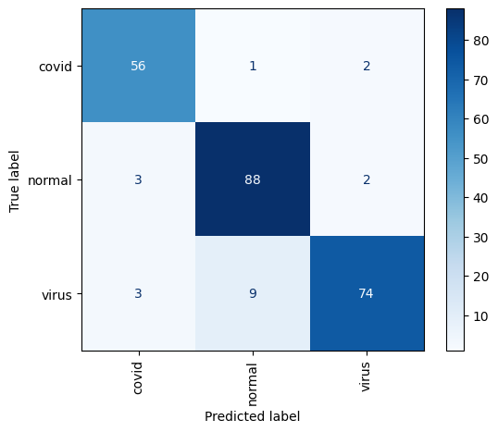
First Experiment (CNN)
For ‘normal’ class:
There is 3 samples missed as ‘covid’, and 2 samples missed as ‘virus’.
For ‘covid’ class:
There is 1 sample missed as ‘normal’, and 2 samples missed as ‘virus’.
For ‘virus’ class:
There is 3 samples missed as ‘covid’, and 9 samples missed as ‘normal’.
With total missed classified samples 20

Slide 10
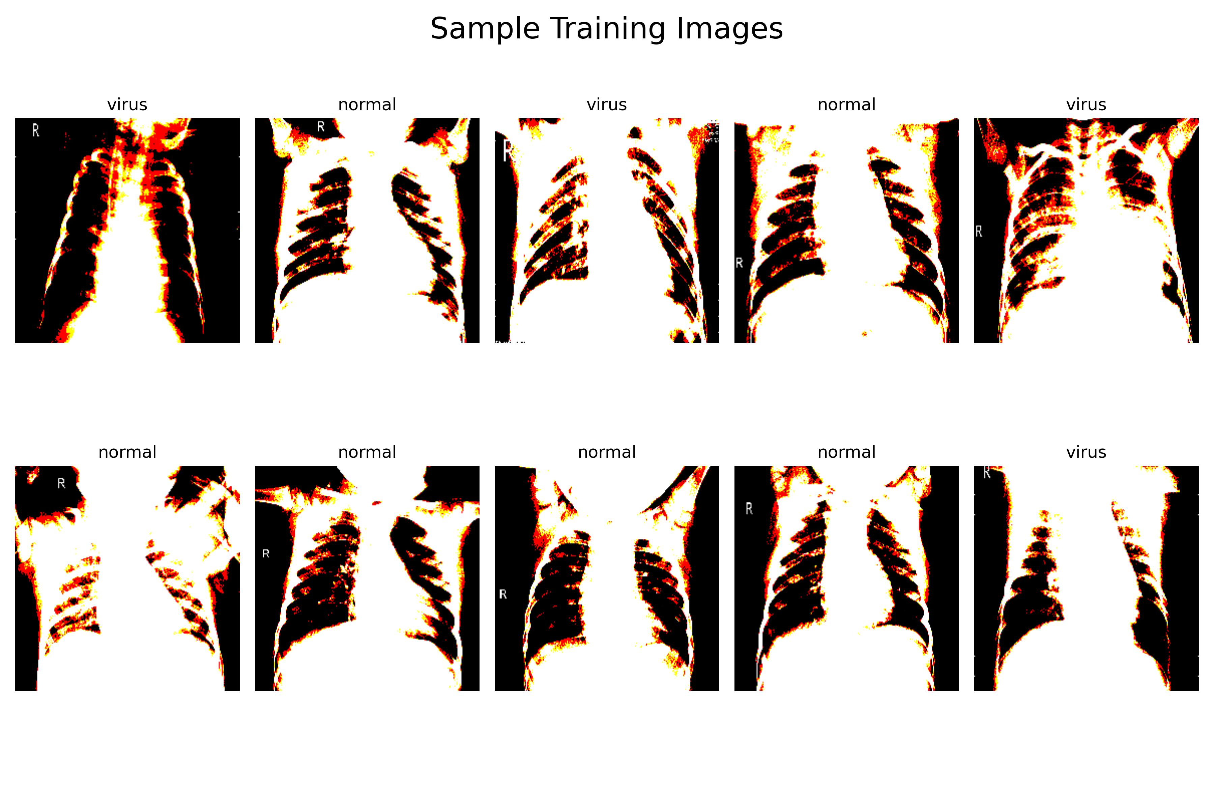
Second Experiment (resnet50)
ResNet50 is a pre-trained model we used to improve our diagnosis and model performance, but we used different pre-processing technique for it

Slide 11
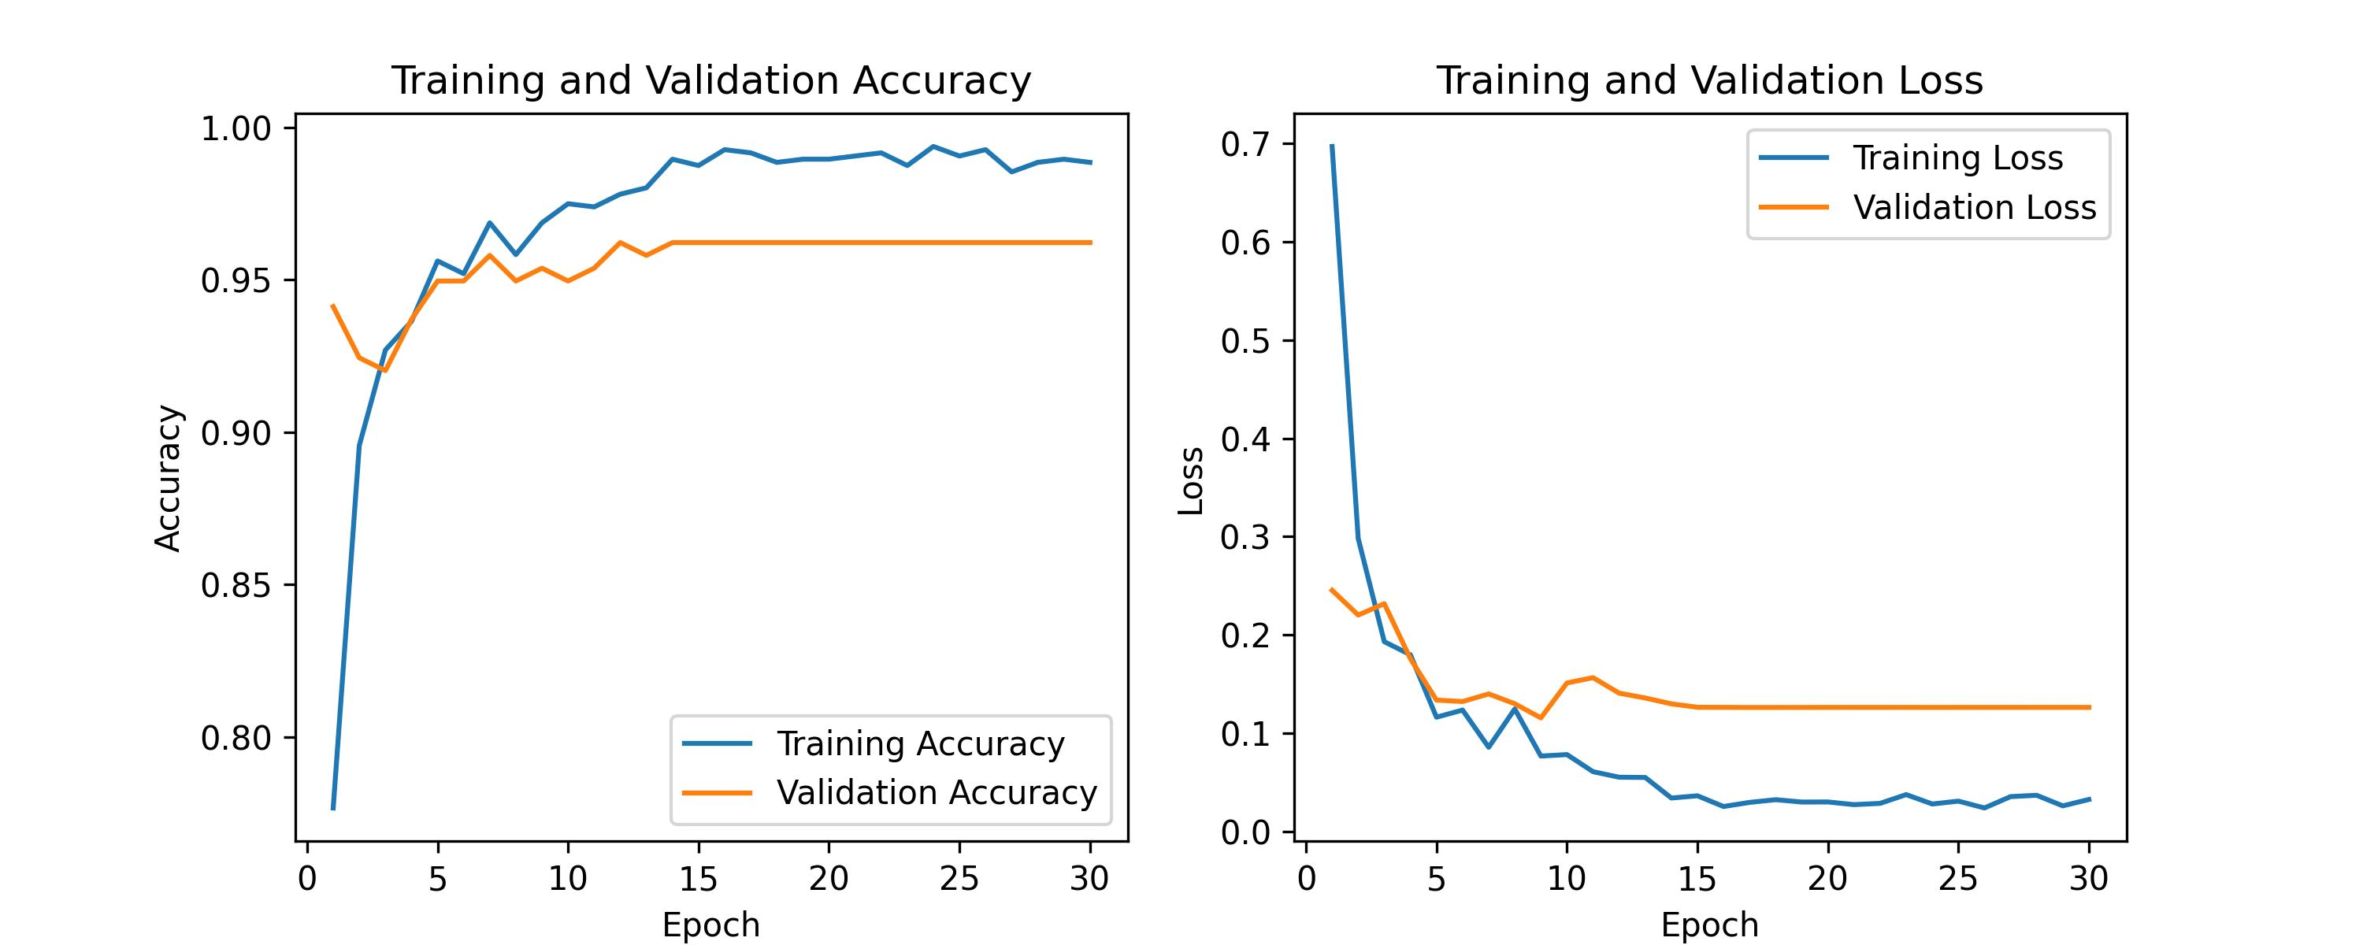
Second Experiment (resnet50)
Train loss: 0.0631
Test loss: 0.1263
Train accuracy: 0.9752%
Test accuracy: 0.9621%

Slide 12
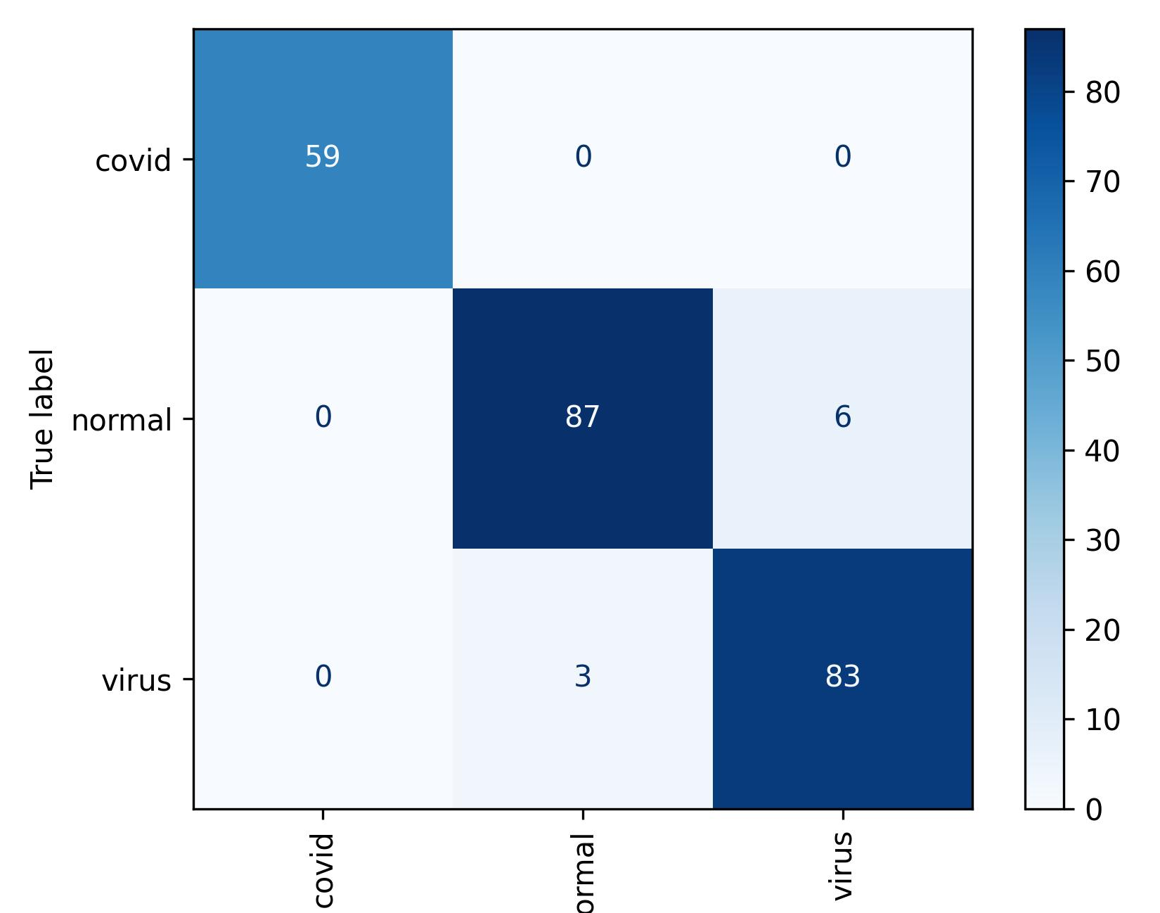
Second Experiment (resnet50)
For ‘normal’ class:
There is no missed as ‘covid’, and 6 samples missed as ‘virus’.
For ‘covid’ class:
All samples classified correctly
For ‘virus’ class:
There is no missed as ‘covid’, and 3 samples missed as ‘normal’.
With total missed classified samples 9

Slide 13
CNN or Resnet50?
CNN
ResNet50
Train accuracy: 0.9120%
Test accuracy: 0.8907%
Train loss: 0.2787
Test loss: 0.2877
Train accuracy: 0.9752 %
Test accuracy: 0.9621%
Train loss: 0.0631
Test loss: 0.1263

Slide 14

Submission
Using ensemble learning to aggregate our two experiments by averaging the output of these models, then sent it for scoring

Slide 15
Thanks for attention

